Slide 1
Data Structure
MTHR2207
Md. Manowarul Islam
Dept. of CSE, Jagannath University

Slide 2
Binary Search Tree (BST)
- It is a hierarchical, nonlinear data structure.
- Its properties are given bellow:
- Each node has a value.
- A total order is defined on these node values.
- Left subtree of a node contains the values less than the node’s value.
- Right subtree of a node contains the values greater than or equal to
the node’s value.
Example:
8
Root R
3
12
Left Subtree
1
6
9
14
Right Subtree
2
10

Slide 3
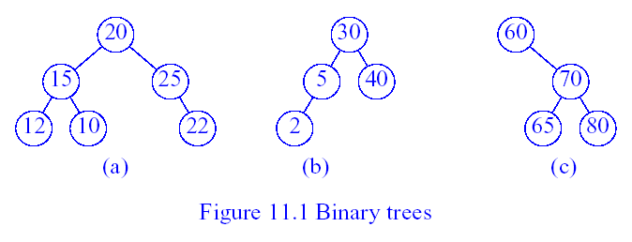
Examples of Binary Trees
Binary Trees
Which of the above trees are binary search trees?
→ (b) and (c)
Why isn’t (a) a binary search tree?
→ It violates the property #3

Slide 4
Binary Search Trees: Examples
root
root
14
C
10
16
A
D
root
8
11
15
18
14
10
16
8
11
15

Slide 5
Sorting of A List of Items Using BST
A binary search tree can be used to implement a simple but inefficient sorting algorithm.
Two steps are followed for sorting:
- TreeNode := Create_BST(List of Items)
- Traverse_InOrder(TreeNode)
Example:
List of Items: 50, 10, 5, 100, 120, 90, 20
BST:
Inorder Traverse: 5, 10, 20, 50, 90, 100, 120 [Sorted List]
50
10
100
5
20
90
120

Slide 6
The Operation Ascend()
20
10
40
6
15
30
2
8
25
How can we output all elements in ascending order of keys?
  Do an inorder traversal (left, root, right).
What would be the output?
  2, 6, 8, 10, 15, 20, 25, 30, 40

Slide 7
Sorting with a BST
Given a BST can you output its keys in sorted order?
Visit keys with Inorder:
- visit left
- print root
- visit right
Example:
C
A
L
B
M
Inorder visit prints:
A B C L M

Slide 8
Searching for a key in a BST
Example:
compare x to key of root:
- if x = key return
- if x < key => search in L
- if x > key => search in R
search L or R in the exact
same way
14
10
16
8
11
15
x=8 is ??? X=17 is ???

Slide 9
Searching a node with a specific value from BST Rules
Examine the root R.
If the searching value equals the root, then the value exists in the tree.
If it is less than the root, then it must be in the left subtree.
If it is greater than the root, then it must be in the right subtree.
This process continues until the searching value is found or a leaf node is reached without having that value where it would be.
Algorithm
Search_BST(Root, Left, Right, Key)
1. Loc := Search(Root, Key, NULL)
2. If Loc = NULL then Print: “Item not in BST”.
3. Else Print: “Item is in BST”.
4. End.
Here,
Root = Root of BST
Left = Left Subtree
Right = Right Subtree
Key = Searching Item

Slide 10
Search(Node, Key, Par)
1. If Node = NULL then return NULL.
2. If Key < Node.Key then Search(Node.Left, Key, Node).
3. Else if Key > Node.Key then Search(Node.Right, Key, Node).
4. Else return Node
Example:
Searching Item: 12
Steps:
Search(Root, 12) Search(AA,12)
Search(AA->Left,12) Search(BB, 12)
Search(BB->Left, 12) Search(DD, 12)
Return DD and Print: Item is in BST.
AA
15
BB
CC
13
100
DD
EE
12
90

Slide 11
Inserting a Node into a BST
Rules
Examine the root R.
If the new value is less than the root’s, then it must be inserted at the left subtree.
Otherwise it must be inserted at the right subtree.
This process continues until the new value is compared with a leaf node and then it is added as that node’s (leaf node) left or right child depending on its value.
Algorithm
Insert_BST(Root, Left, Right, Item)
1. Set NewNode.Value := Item.
2. Insert(Root, NewNode).
End.
Here,
Root = Root of BST
Left = Left Subtree
Right = Right Subtree
Item = New Item to be inserted

Slide 12
Insert Example
We wish to insert an element with the key 35.
Where should it be inserted?
20
10
40
6
15
30
2
8
25
35

Slide 13
Insert Example
Insert an element with the key 7.
20
10
40
6
15
30
2
8
25
35
7

Slide 14
Insert Example
Insert an element with the key 18.
20
10
40
6
15
30
2
8
18
25
35
7

Slide 15
Insert(Node, NewNode)
If Node = NULL then Node := NewNode and return.
If NewNode.Value < Node.Value then Insert(Node.Left, NewNode).
Else Insert(Node.Right, NewNode).
Example:
New Item: 110
FF.Value=110 (FF is the New Node address)
Steps:
1. Insert(Root, FF) Insert(AA, FF)
2. Insert(AA->Right, FF) Insert(CC, FF)
3. Insert(CC->Right, FF)
AA
15
BB
CC
13
100
DD
EE
FF
12
90
110
Figure: BST with 5 Nodes

Slide 16
Building a BST
Build a BST from a sequence of nodes read one a time
Example: Inserting C A B L M (in this order!)
1) Insert C
2) Insert A
C
C
A

Slide 17
Building a BST
3) Insert B
C
5) Insert M
A
C
B
A
L
4) Insert L
C
B
M
A
L
B

Slide 18
Building a BST
Is there a unique BST for letters A B C L M ?
NO! Different input sequences result in different trees
Inserting: A B C L M
Inserting: C A B L M
A
B
C
C
L
A
L
B
M
M

Slide 19
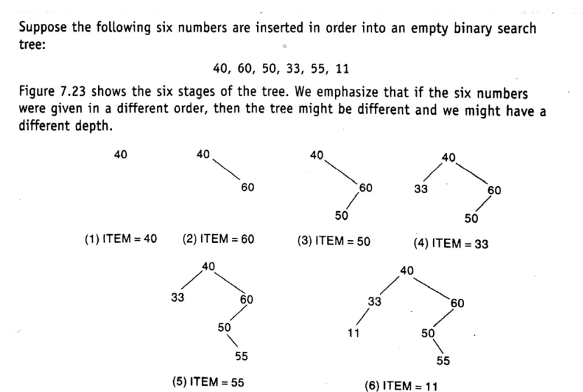
Building a BST

Slide 20
Deleting a Node from BST
Rules
- A node N has no children. N is deleted from BST by simply replacing the
location of N in the parent node P(N) by the NULL pointer.
- A node N has one child. N is deleted from BST by simply replacing the location
of N in the parent node P(N) by the location of the only child of N.
- A node N has two children. Let S(N) denote the inorder successor of N. N is
deleted from BST by first deleting S(N) from BST and then replacing node N
by S(N).

Slide 21
Example:
Deleted Item: 15
Loc = AA and Par = NULL
Steps:
Delete_A(Root, Loc, Par)
Inorder Successor, S(Loc) = EE
Delete EE from BST
Replace AA by EE by EE.Left = AA.Left and EE.Right := AA.Right.
AA
15
BB
CC
13
100
DD
EE
FF
12
90
110
Figure: Given BST
EE
90
BB
CC
13
100
After Delete Operation
DD
Figure: Resulting BST
FF
12
110

Slide 22
The Operation Delete(key, e)
For deletion, there are three cases for the element to be deleted:
  Element is in a leaf.
  Element is in a degree 1 node (i.e., has exactly one nonempty subtree).
  Element is in a degree 2 node (i.e., has exactly two nonempty subtrees).

Slide 23
Case 1: Delete from a Leaf
For case 1, we can simply discard the leaf node.
Example, delete a leaf element. key=7
20
10
40
6
15
30
2
8
18
25
35
7

Slide 24
Case 1: Delete from a Leaf
Delete a leaf element. key=35
20
10
40
6
15
30
2
8
18
25
35

Slide 25
Case 2: Delete from a Degree 1 Node
20
10
40
6
15
30
2
8
18
25
Which nodes have a degree 1?
Example: Delete key=40

Slide 26
Case 2: Delete from a Degree 1 Node
Delete from a degree 1 node. key=15
20
10
6
15
30
2
8
18
25

Slide 27
Case 3: Delete from a Degree 2 Node
20
10
40
6
15
30
2
8
18
25
35
7
Which nodes have a degree 2?
Example: Delete key=10

Slide 28
Case 3: Delete from a Degree 2 Node
20
10
40
6
15
30
2
8
18
25
35
7
Replace with the largest key in the left subtree
(or the smallest in the right subtree)
Which node is the largest key in the left subtree?

Slide 29
Case 3: Delete from a Degree 2 Node
20
8
40
6
15
30
2
8
18
25
35
7
The largest key must be in a leaf or degree 1 node.

Slide 30
Case 3: Delete from a Degree 2 Node
Note that the node with largest key in the left subtree (as well as that with smallest in the right subtree) is guaranteed to be in a node with either zero or one nonempty subtree
How can we find the node with largest key in the left subtree of a node?
➔ by moving to the root of that subtree and then following a sequence of right-child pointers until we reach a node whose right-child pointer is NULL
How can we find the node with smallest key in the right subtree of a node?
➔ by moving to the root of that subtree and then following a sequence of left-child pointers until we reach a node whose left-child pointer is NULL

Slide 31
Example:
AA
15
Inorder Traversal: 12, 13, 15, 90, 100, 110
Preorder Traversal : 15, 13, 12, 100, 90, 110
Postorder Traversal : 12, 13, 90, 110, 100, 15
BB
CC
13
100
DD
EE
FF
12
90
110
Figure: Binary Search Tree

Slide 32
End

